Slide 1



Technical entrepreneurship
Notes:
Welcome; Intro; Transition to about me :)

Slide 2


Who’s Niki?
@nirinchev
nirinchev
Notes:
BSc theoretical physics @SU
2 years Silverlight/WCF B2B + some mobile Xamarin - MotoTest, BiBlocks
A year @Telerik - AppBuilder
Almost a year @Clusterize
Almost exclusively .NET stack

Slide 3
Working in a startup
Notes:
Initial words of “wisdom”
Not a job, it’s a life
Don’t reinvent the wheel - use 3rd party services and libraries as much as possible
Don’t hack

Slide 4
Course overview
Mobile-first SaaS in the Cloud
Stack selection (.NET)
Microservices architecture
“Native” mobile development
(TBD)
Notes:
Днес: какво е mobile first. Какво е SaaS, какво е cloud и други такива интересни неща.
Защо хомогенен стек
Как да изберем стек в стартъп
Защо в Clusterize избрахме .NET и дали това е правилният избор за вашия стартъп
Web server с WebAPI и OData - как ще ни помогне в дългосрочен план
Скалируемост на application server-a. microservices architecture и background processing скалиране нагоре и надолу когато ни е удобно
Mobile development - защо Native. Защо Xamarin. Сравнение между различни платформи за mobile development
TBD

Slide 5
Course overview (cont.)
Startup infrastructure
Integration with other services
Analytics (Leanplum)
Node.js (Chaos group)
Hands on lab
Notes:
6. Source control. Deployment. CI. SSL Sertificates.
7. UserVoice, Leanplum, Braintree, Taperecorder, Xamarin Insights
8. TBD
9. TBD
10. Hands on - ще се пробваме да обединим всичко научено и ще проверим докъде ще стигнем

Slide 6

Agenda for today
What is and why Mobile-first
What is SaaS
What is Cloud and why SaaS in the Cloud
Azure overview

Slide 7
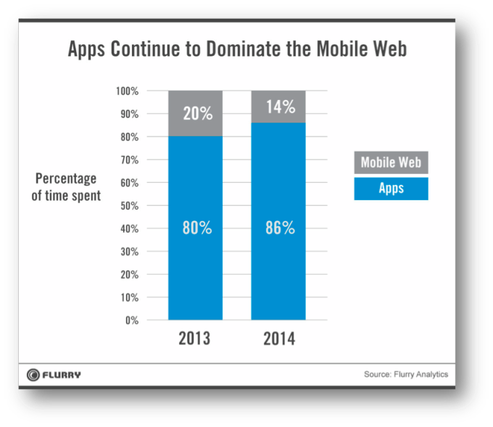
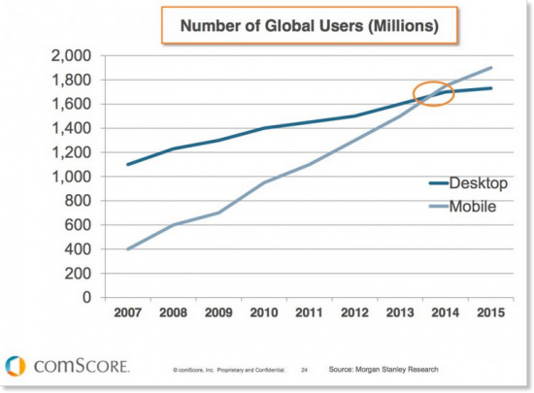
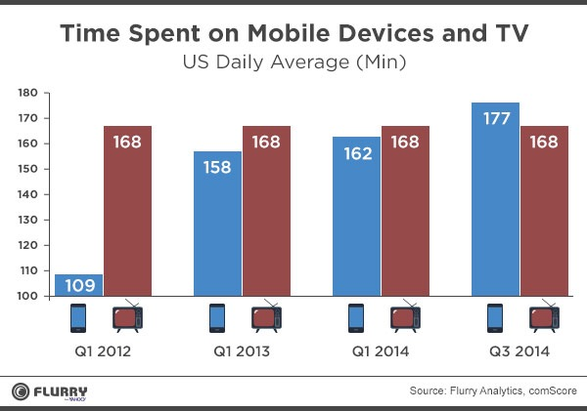
It’s the Present
Notes:
More smartphones than PCs. Potentially larger userbase. Better demographic - younger more tech savvy people.
Extremely engaging - more time spent on smartphone than TV
По-детайлно в лекция 4, но за пълнота: Apps > web - people spend much more time in apps than browsing

Slide 8
Focus on what’s important
Notes:
twitter.com vs m.twitter.com
facebook.com vs m.facebook.com
Size and performance constraints force a focused and creative approach. Flash websites. 3G networks - generally slower and unreliable; remove bling bling in favor of useful content

Slide 9
New ways to interact
Geolocation
Push notifications
Integration with calendar/phonebook
NFC, beacons
Notes:
Geolocation - provide more relevant information
Push notifications - push based vs pull based model, great for reactivation and engagement. Always on, almost always with the wearer. More engaging experiences.
Integration with OS functions - read and write calendar events, read contact information, etc.
NFC, beacons, etc.

Slide 10
Agenda for today
What is and why Mobile-first
What is SaaS
What is Cloud and why SaaS in the Cloud
Azure overview

Slide 11
Examples
Facebook
WoW
Facebook
WoW
Github
Github
StarCraft
StarCraft
Amazon
Amazon
Office 365
Office 365
MS Office
MS Office
Photoshop
Photoshop
Notes:
Definition: Delivery model in which software is licensed on a subscription basis and is centrally hosted. Usually accessed via browser, but could have a heavier client
Benefits
Easier administration
Automatic updates (usually)
Compatibility
Rapid iterations

Slide 12
Agenda for today
What is and why Mobile-first
What is SaaS
What is Cloud and why SaaS in the Cloud
Azure overview
Notes:
Dates back to 1950s
Collective for SaaS/IaaS/PaaS
Multiple providers - Azure, AWS, Google Cloud Platform, Heroku, Rackspace
Greatly simplifies devops
Cheaper
What to look for in a cloud provider:
Does it work for you
Price
SLA
Ease of use

Slide 13
Agenda for today
What is and why Mobile-first
What is SaaS
What is Cloud and why SaaS in the Cloud
Azure overview
Notes:
Microsoft’s cloud computing platform
Main advantage - ease of use + tooling; AWS archaic UI, whereas Azure already has 2 competing portals :D
Take feedback seriously - e.g. pricing

Slide 14
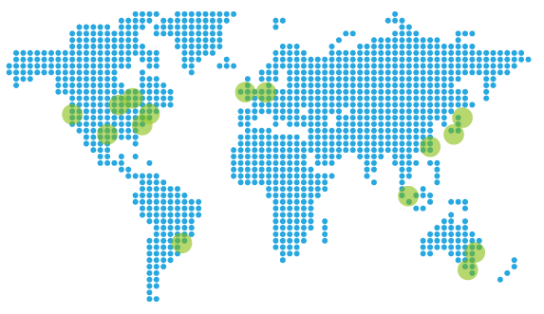
Footprint
Notes:
16 regions (datacenters) over 5 continents
Multiple CDN edges
Apps can be deployed in one or multiple regions; customers get the closest one
Demo
create two apps in different regions
create traffic manager for the two apps
Use https://www.whatsmydns.net/ CNAME to check from different locations

Slide 15
Virtual Machines
Notes:
Most flexible - you are responsible for everything
Sizes from 1 core / 1 GB for $13 to 32 cores / 450 GB for $6500
Windows/Linux
Highlight new portal UI - pricing estimations
Durable - storage is persistent
Can run anything, can choose from gallery
Takes ~10 mins to provision Windows machine, ~5 mins for Linux
Storage is automatically backed up, geo redundant, etc.

Slide 16
Web apps
Notes:
Zero configuration website/web api hosting
Auto managed environment
ASP.NET/Python/Node.js/PHP supported
Extremely easy deployment
Autoscaling
Demo:
Create WebAPI project. Clean it up. Add a ComputeController with Get method that zips some files (Reference Compression), return new { ticks; server guid }. Deploy using web deploy, get credentials on the go. Add to git. Deploy to both Asia and Europe websites
Create load tester console app;
Show gallery e.g. Umbraco
Highlight shared vs reserved mode
Shared: multiple websites use the same VMs
Reserved: reserved resources; Multiple websites in a reserved instance

Slide 17
Azure SQL Databases
Notes:
Azure SQL Database vs SQL server
Low administration cost - don’t care about software updates, backups, availability, etc.
Fast provisioning
Lower costs; DTU (Database throughput unit)
Less features but that’s changing; V12 brings them closer; clustered index requirement dropped; new features will be developed with Azure SQL in mind
Demo: Provision Database in a new server
https://msdn.microsoft.com/en-us/library/azure/dn741336.aspx?f=255&MSPPError=-2147217396
Add User model; add context; create new controller, add post and get methods
Fix firewall using old portal
Browse with SSMS, Open in VS

Slide 18
Redis
Notes:
Advanced KV store; in-memory; Basic - single node, Standard - multiple nodes for resilience; no persistence; Pub/sub alternative to RabbitMQ
Demo:
Create redis helper with TryGet and Set methods
Connection string: MyShortener.redis.cache.windows.net,ssl=true,password=P7EQP0UvTSC8NSnbTszEcFluDi/aF1BEm4pMODmxwQY=
Create Shorten API controller with POST method
Alter RouteConfig - remove controller/action
Add string id parameter on HomeController
if found -> this.Redirect else this.View

Slide 19
Search
Notes:
Search as a service
Roughly equivalent to full text search
Flow:
Create an index
Create an indexer (scheduled data crawler; works on SQL Server/DocumentDB) or push data
Search
Demo:
Create SearchHelper<T> with: CreateIndex(), PopulateData(IEnumerable<T>), Search(string)
Create CompanyInfo

Slide 20
Other PaaS offerings
DocumentDB
Blob Storage
Push notifications
Machine learning
Analytics
CDN
Media services
Active directory

Slide 21
Q&A

